Slide 1




Machine learning
Case study
Flight Price Analysis
Submitted By ,
M.kavitha

Slide 2
ACKNOWLEDGMENT
This presentation includes the flight price prediction done by myself with reference to the data analysis prepared by me using web scraping from the website Yatra .Also referred to Google for some detailed learning in the analysis report writing for the completion of the project.

Slide 3
INTRODUCTION Business Problem Framing
With the covid 19 impact in the market, we have seen lot of changes in the Economics market.People travel for Business around the Country to explore the business .They are in the situation to make their business fast and so they prefer making their trips in short so they avail booking flight for maximum less price.They will be ahead in booking the flight in advance according to their plan.We are going to scrape and find out in the social website how far we can reduce our travel charges by booking in advance.Here we have collected the data in Yatra.com ,finding the flight availability for some source and Destination at less price.With the change in market due to covid 19 impact, our client is facing problems with their previous booked flight changes and cancellation charges. So, they are looking for new machine learning models from new data. We have to make Flight charges according to the collected data and analyze the model and predict the price charges.

Slide 4
Conceptual Background of the Domain Problem
The objective of this article is to predict flight prices given the various parameters. Data used in this article is was scraped from Yatra.com.
The data of Flight services available for few dates from the Location NewDelhi to Mumbai from the website Yatra.com We used web scraping for this. We fetched data for above mentioned locations. The number of columns for data depends on the proper scraping we are doing and also the website which we are scraping .
The dataset contains the data of the used Flight Sevices available on different dates.On the basis of the data we have to predict the price of the Flight charges.The dataset contains the data like details of the 'Airline', 'Date_of_Journey', 'Source', 'Destination', 'Dep_Time','Arrival_Time', 'Duration', 'Total_Stops', 'Price'.

Slide 5
Review of Literature:
I started the Research by first reading and analyzing the data collected by myself . Price is the target column here. All the features are then analyzed, missing data handling, outlier detection, data cleaning are done. New features are extracted, redundant features dropped and categorical features are encoded accordingly. Then the data is split into train and test data and feature scaling is performed and finally model building is done with Hyper Parameter Tuning done with best parameters observed.

Slide 6
Motivation for the Problem Undertaken
Airline companies use complex algorithms to calculate flight prices given various conditions present at that particular time. These methods take financial, marketing, and various social factors into account to predict flight prices.
Nowadays, the number of people using flights has increased significantly. It is difficult for airlines to maintain prices since prices change dynamically due to different conditions. That’s why we will try to use machine learning to solve this problem. This can help airlines by predicting what prices they can maintain. It can also help customers to predict future flight prices and plan their journey accordingly.
The main Objective behind the project is to perform the given task successfully and analyze the dataset thoroughly, learn the objective concepts and perform the prediction according to the provided dataset.
This will be a regression problem since the target or dependent variable is the price (continuous numeric value).

Slide 7
Analytical Problem Framing · Mathematical/ Analytical Modeling of the Problem
1.Importing modules, Reading the data 2.Analyzing Numerical Features
Checking Statistical summary
Checking Distribution of numerical features . Inspecting Correlation
Missing Value Handling
Encoding Categorical Features
Correcting data type
Univariate and Bivariate analysis,
DataVisualization

Slide 8
3.Analyzing Categorical Features
Missing Value Handling
Encoding Categorical Features
Data Visualization
Dropping Redundant Features
4.Splitting data into Train and Test data 5.Comparing model coefficients
6.Model Evaluation
7.Choosing the final model and most significant features.
8.Evaluation of Regressor Models
9.HyperParameter Tuning.
10.Conclusion.

Slide 9
Data Sources and their formats
Data contains 1619 rows × 9 columns entries each having 9 variables. • Data does not have Null values. • Extensive EDA is performed to gain relationships of important variables and price.
• Data contains numerical as well as categorical variables.
• We have to build Machine Learning models, apply Regressor model coefficients and determine the optimal values of Hyper Parameters.
• We need to find important features which affect the price.

Slide 10
Data Description:
The procedure of extracting information from given raw data is called data analysis. Here we will use EDA module of the data-prep library to do this step.
First, we will import the required libraries

Slide 11
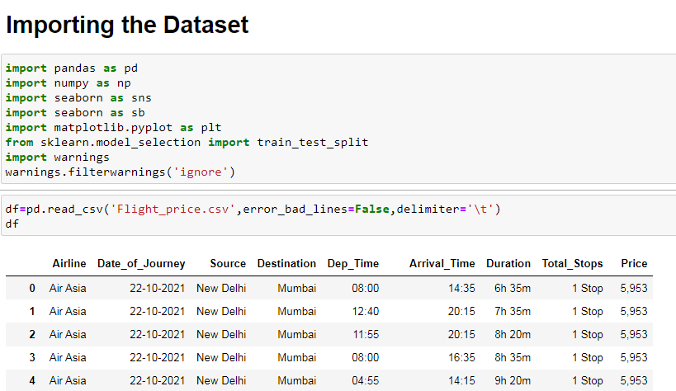
Importing Dataset

Slide 12
Airline: Name of the airline used for traveling
Date_of_Journey: Date at which a person travelled
Source: Starting location of flight
Destination: Ending location of flight
Dep_Time: Departure time of flight from starting location
Arrival_Time: Arrival time of flight at destination
Duration: Duration of flight in hours/minutes
Total_Stops: Number of total stops flight took before landing at the destination.
Price: Price of the flight

Slide 13
Few observations about some of the variables:
1. ‘Price‘ will be our dependent variable and all remaining variables can be used as independent variables.
2. ‘Total_Stops‘ can be used to determine if the flight was direct or connecting.

Slide 14
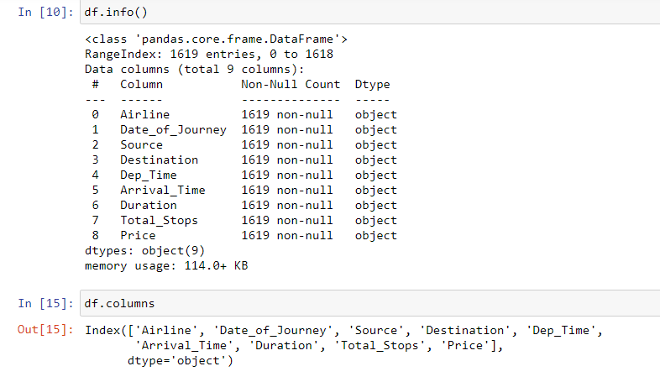

Slide 15
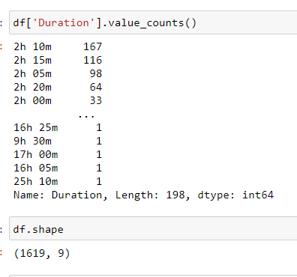

Slide 16
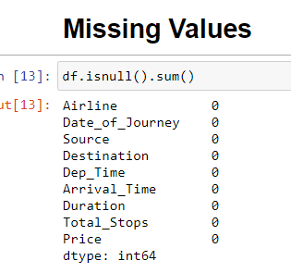

Slide 17
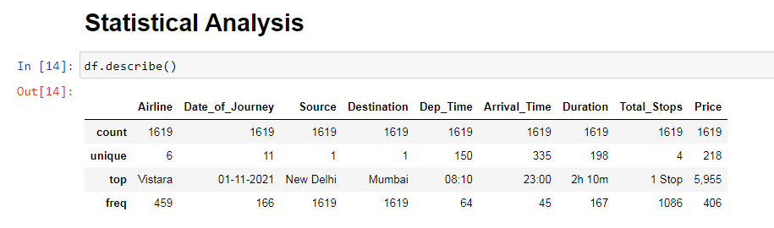

Slide 18
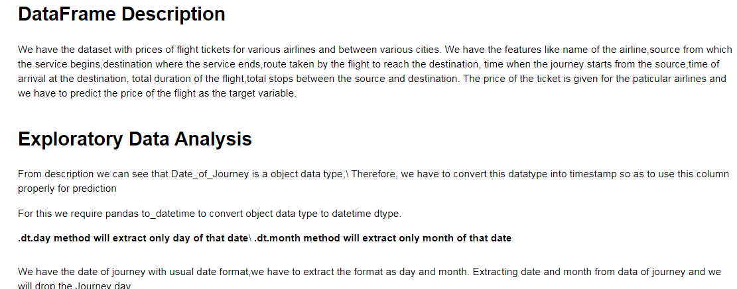

Slide 19
Handling Date and Time Variables:
We have ‘Date_of_Journey’, a ‘date type variable and ‘Dep_Time’, ‘Arrival_Time’ that captures time information.
We can extract ‘Journey_day’ and ‘Journey_Month’ from the ‘Date_of_Journey’ variable. ‘Journey day’ shows the day of the month on which the journey was started.

Slide 20
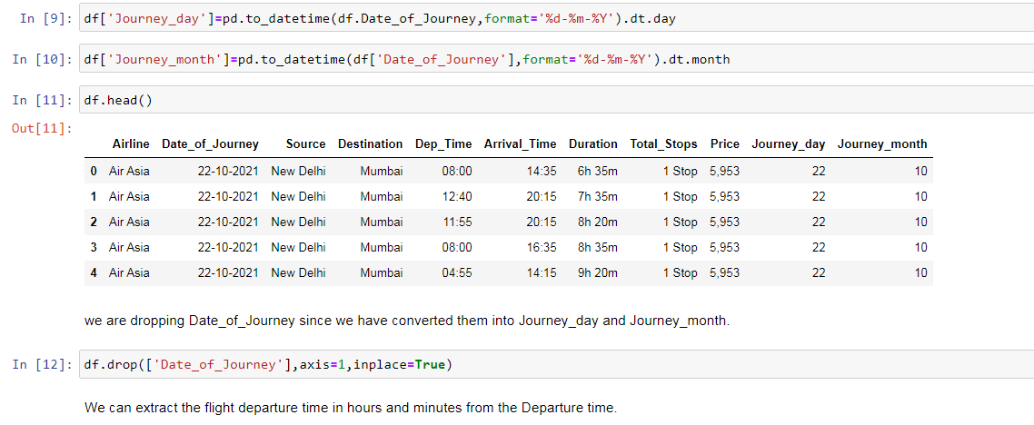

Slide 21
Similarly, we can extract ‘Departure_Hour’ and ‘Departure_Minute’ as well as ‘Arrival_Hour and ‘Arrival_Minute’ from ‘Dep_Time’ and ‘Arrival_Time’ variables respectively.

Slide 22
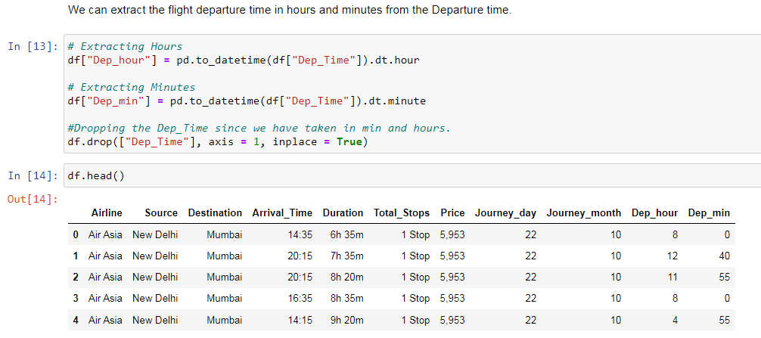

Slide 23
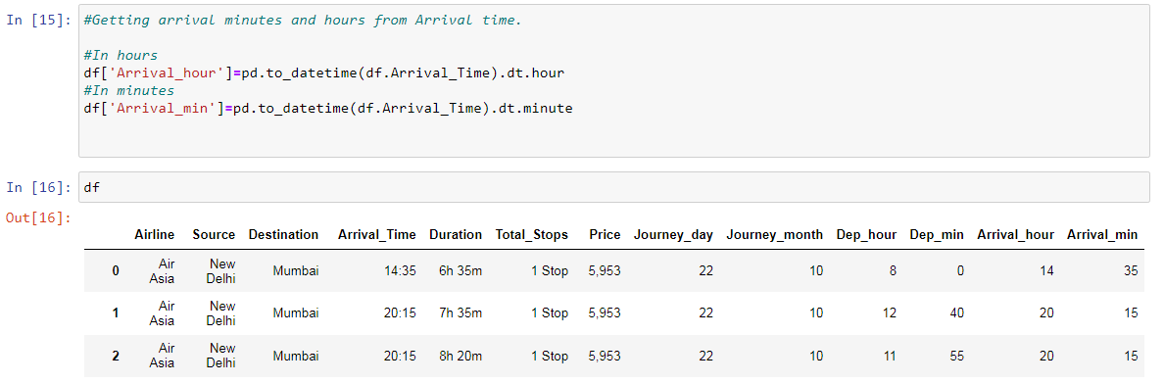

Slide 24
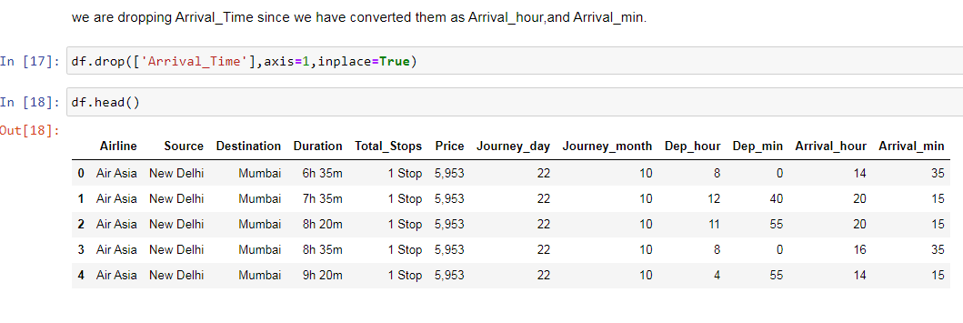

Slide 25
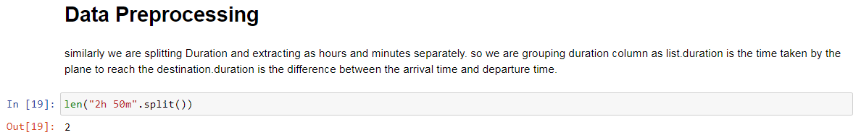
We also have duration information on the ‘Duration’ variable. This variable contains both duration hours and minutes information combined.
We can extract ‘Duration_hours’ and ‘Duration_minutes’ separately from the ‘Duration’ variable.

Slide 26
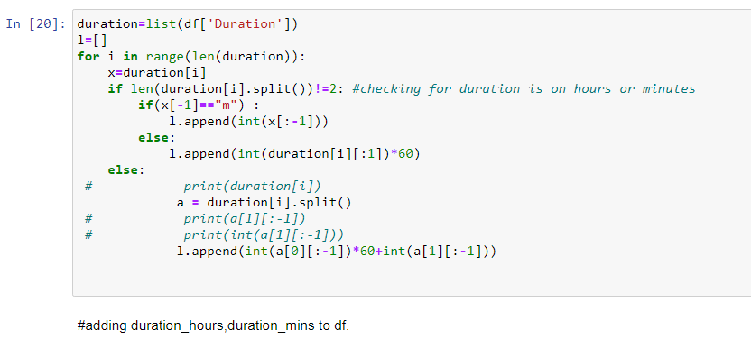

Slide 27
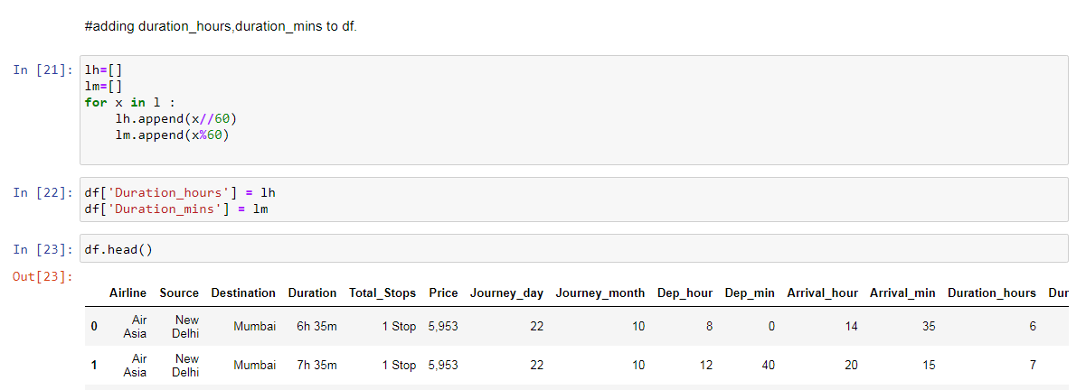

Slide 28
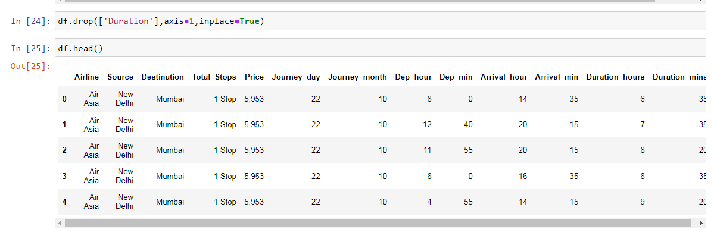

Slide 29
Handling Categorical Data
Airline, Source, Destination, Total_Stops are the categorical variables we have in our data. Let’s handle each one by one.

Slide 30
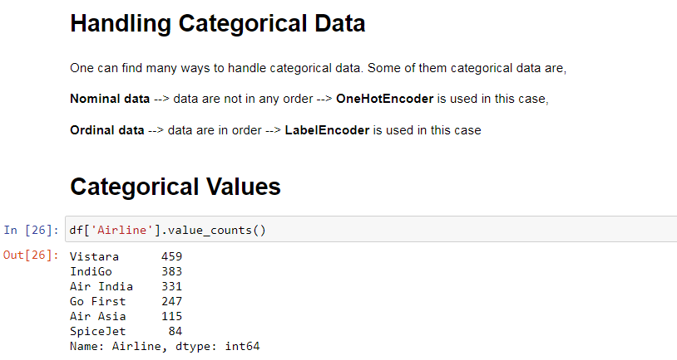

Slide 31
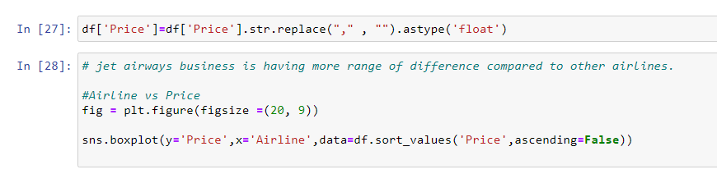

Slide 32
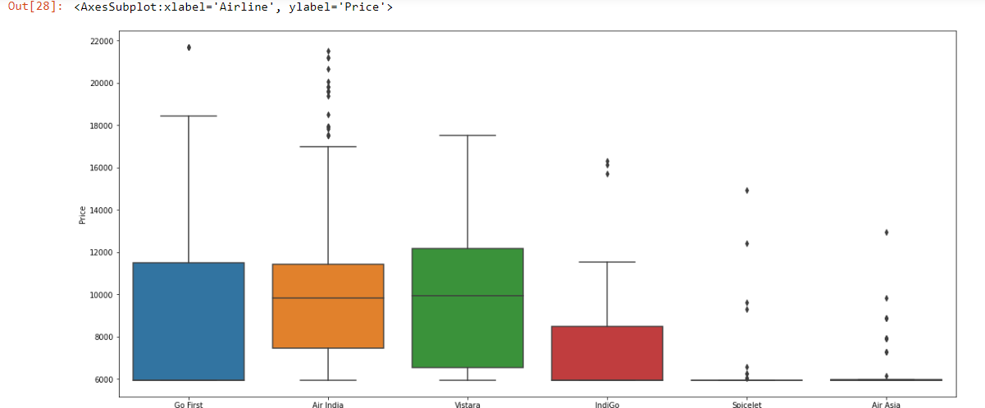

Slide 33
As we can see the name of the airline matters. ‘Vistara’ has the highest price range. Other airlines price also varies.
Since the Airline variable is Nominal Categorical Data (There is no order of any kind in airline names) we will use one-hot encoding to handle this variable.

Slide 34
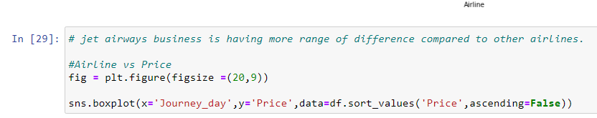

Slide 35
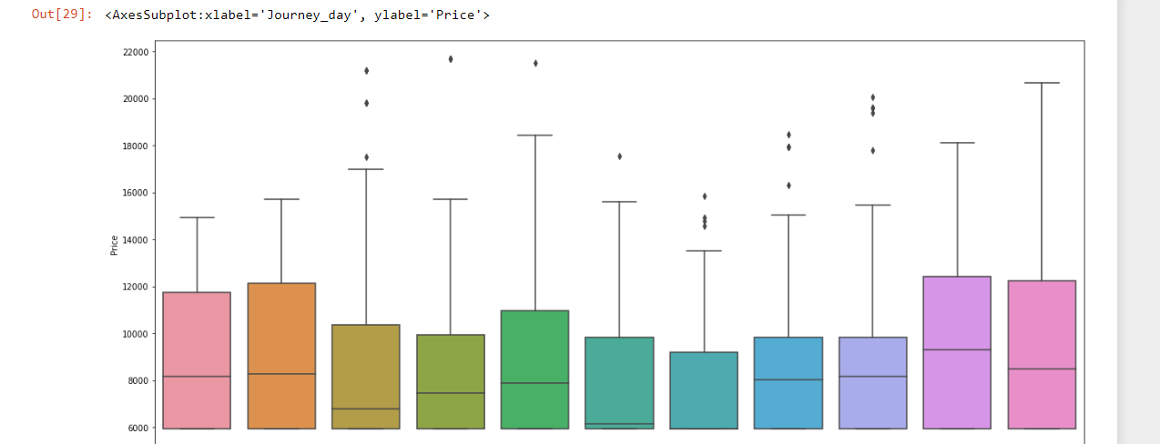

Slide 36
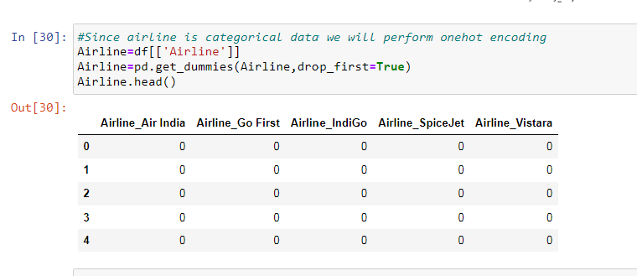

Slide 37
One-Hot encoded ‘Airline’ data is saved in the Airline variable as shown in the above code.

Slide 38
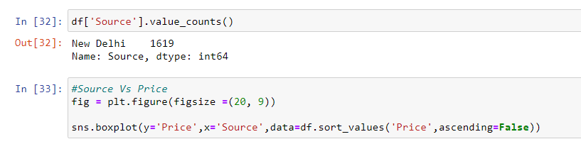

Slide 39
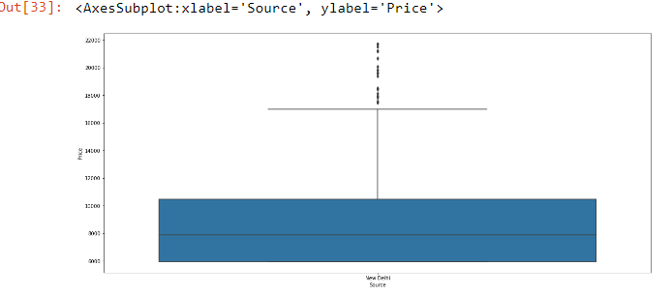

Slide 40
Source and Destination Variable
Again ‘Source’ and ‘Destination’ variables are Nominal Categorical Data. We will use One-Hot encoding again to handle these two variables.

Slide 41
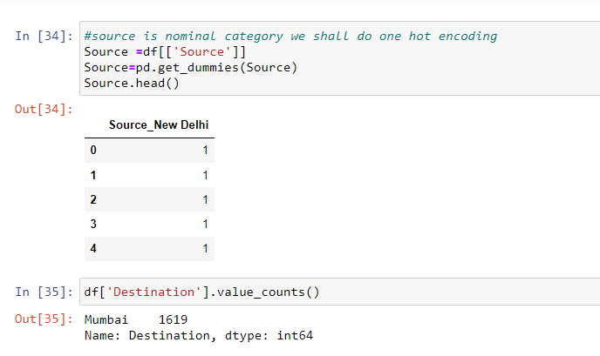

Slide 42
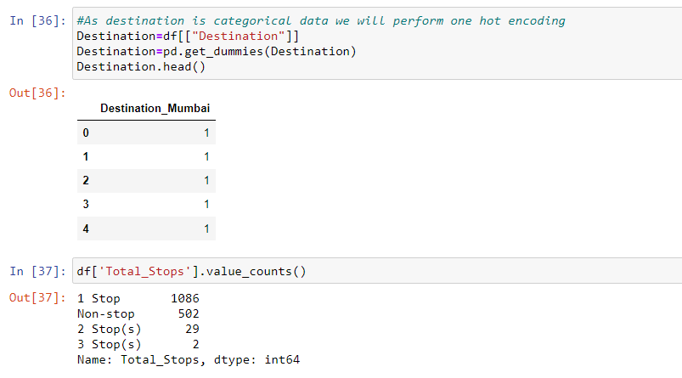

Slide 43
Here, non-stop means 0 stops which means direct flight. Similarly meaning other values is obvious. We can see it is an Ordinal Categorical Data so we will use LabelEncoder here to handle this variable.

Slide 44
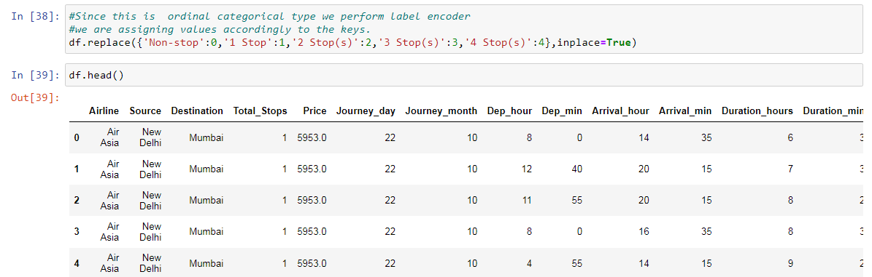

Slide 45
Final Dataframe
Now we will create the final dataframe by concatenating all the One-hot and Label-encoded features to the original dataframe. We will also remove original variables using which we have prepared new encoded variables.

Slide 46
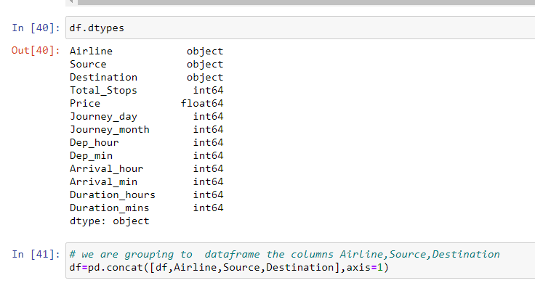

Slide 47
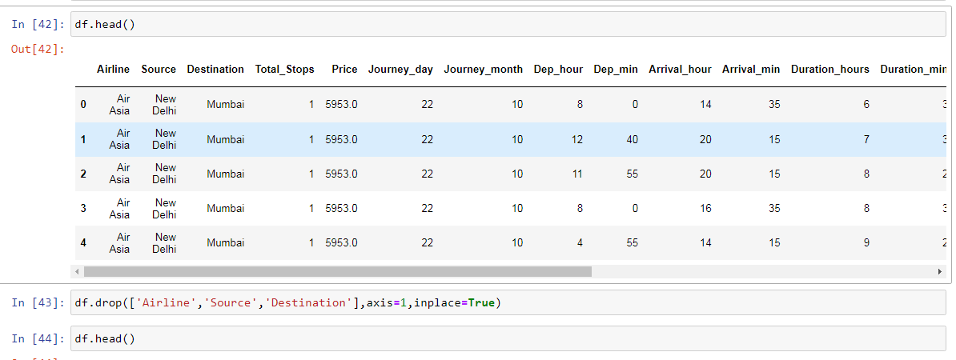

Slide 48
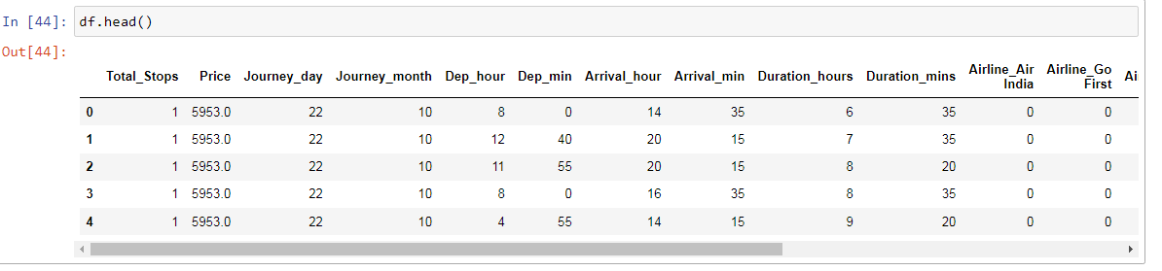

Slide 49
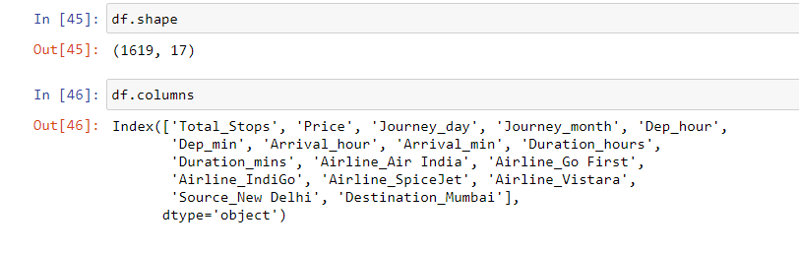
Let’s see the number of final variables we have in dataframe.

Slide 50
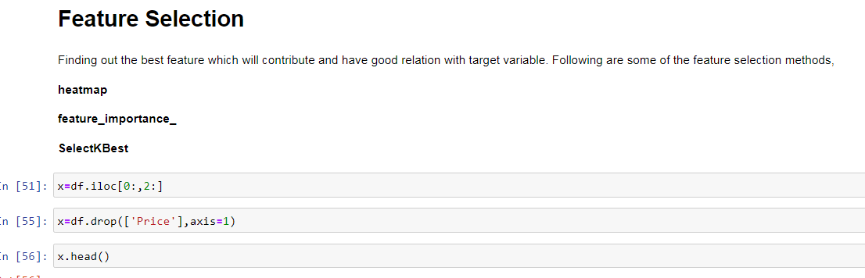

Slide 51
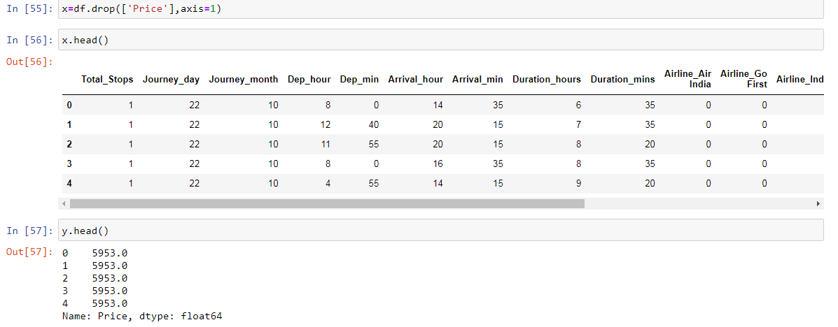

Slide 52
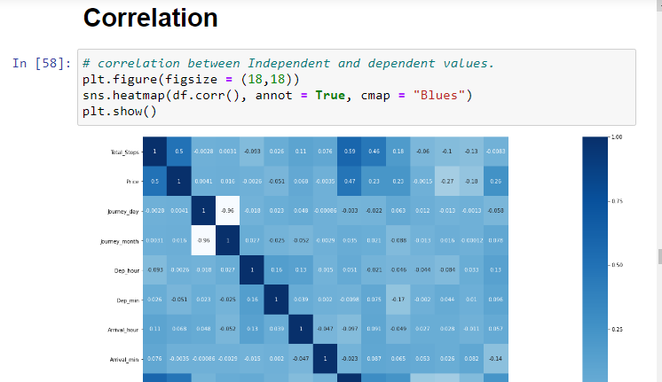

Slide 53
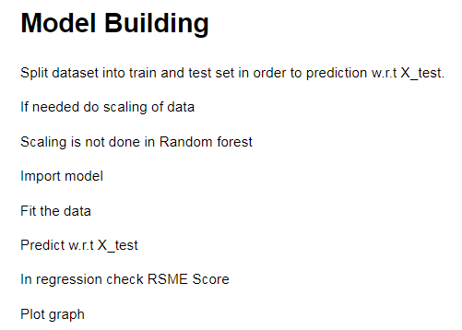

Slide 54
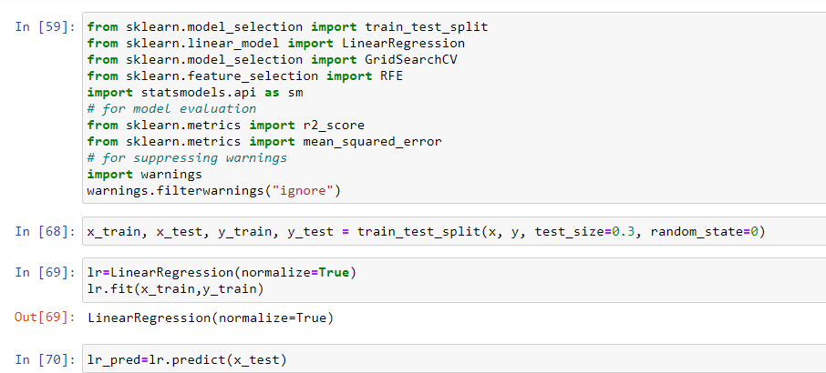

Slide 55
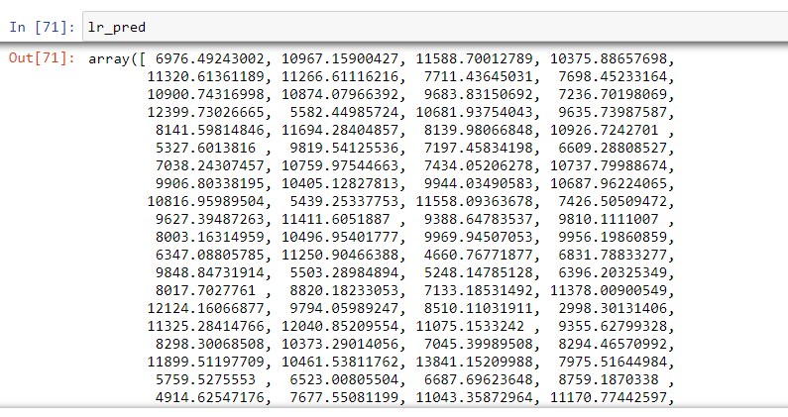

Slide 56
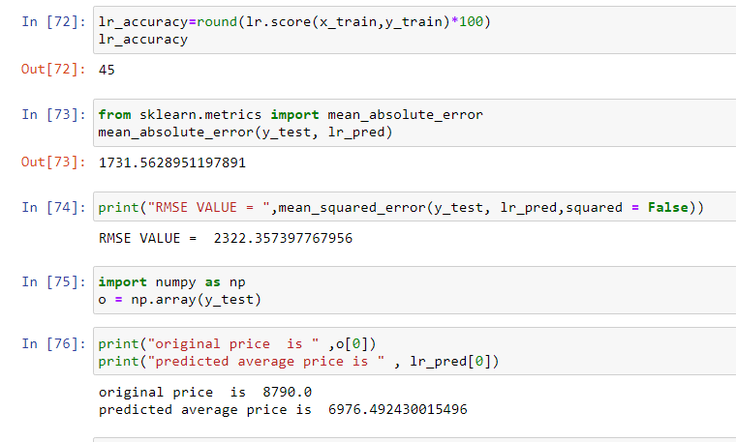

Slide 57
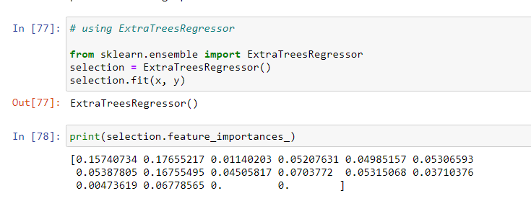

Slide 58
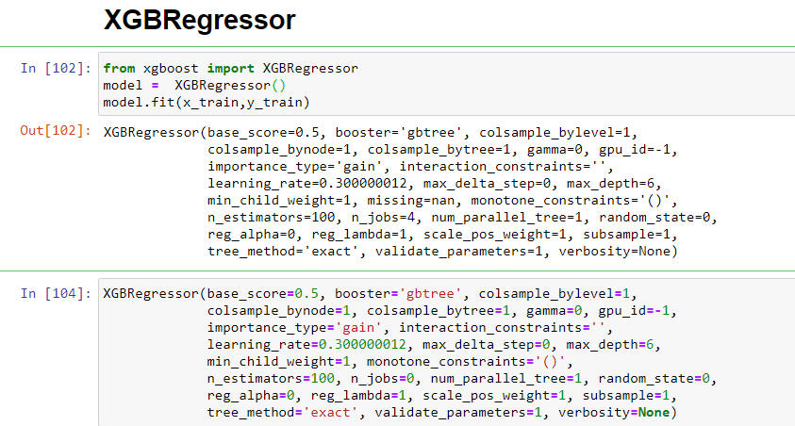

Slide 59
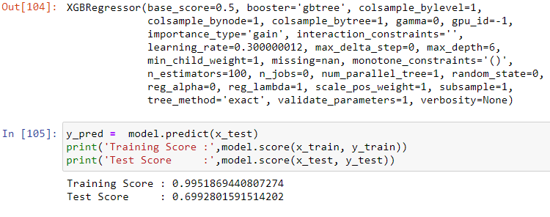

Slide 60
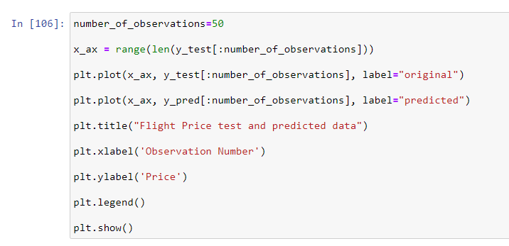

Slide 61
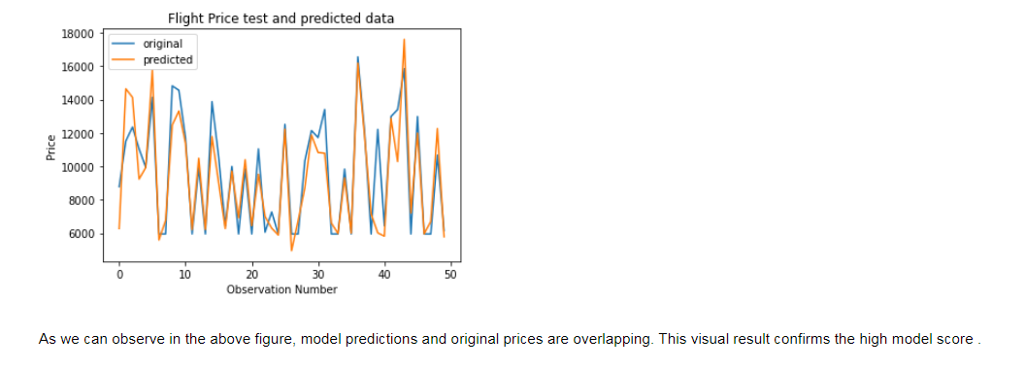

Slide 62
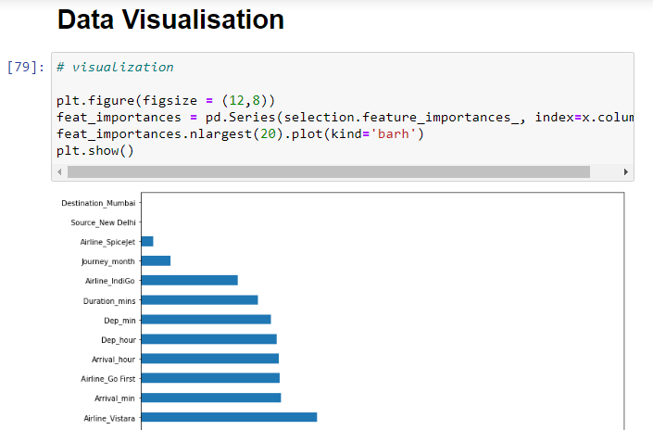

Slide 63
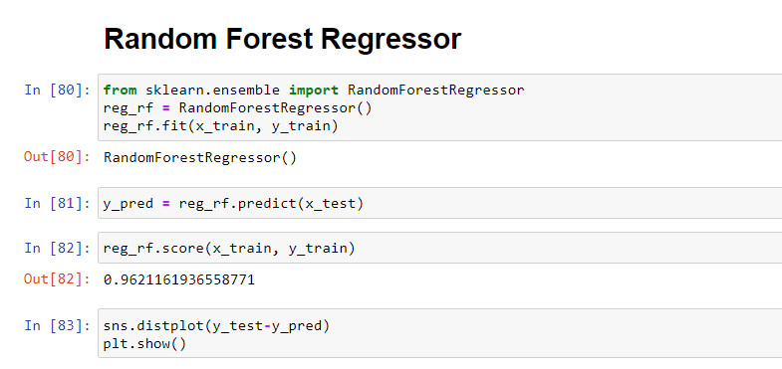

Slide 64
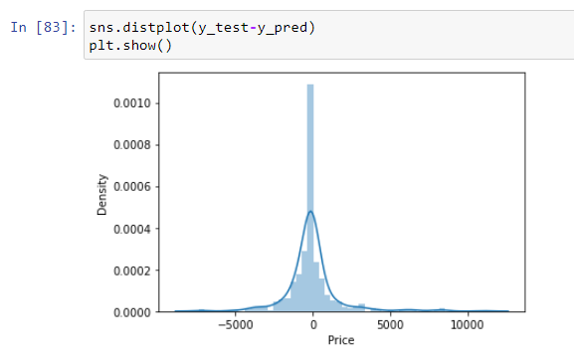

Slide 65
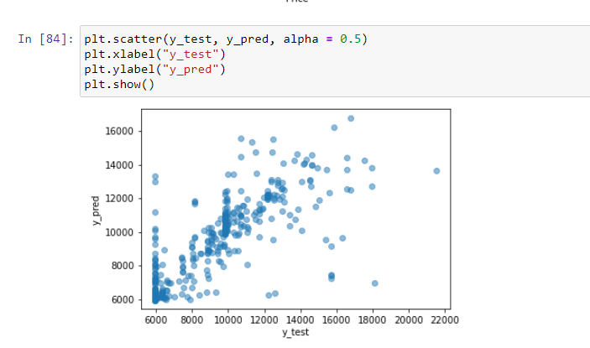

Slide 66
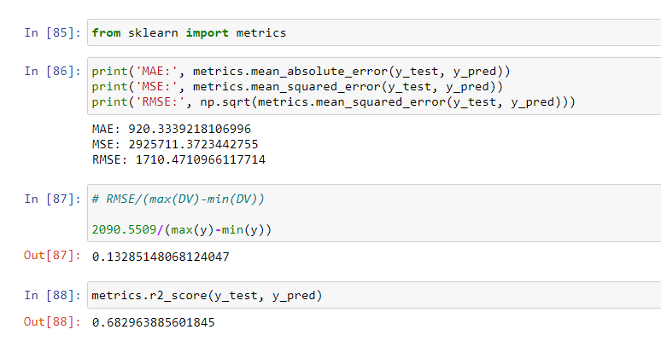

Slide 67
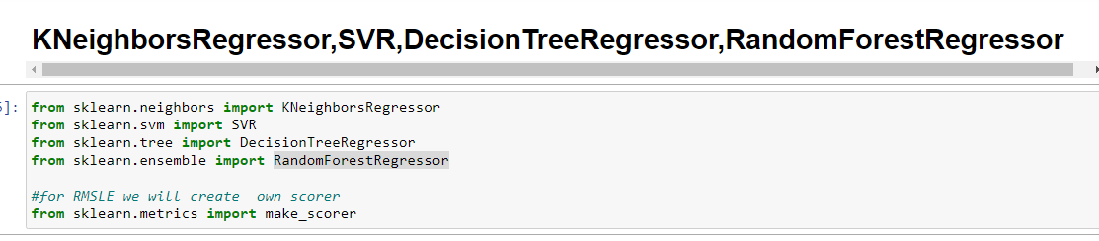

Slide 68
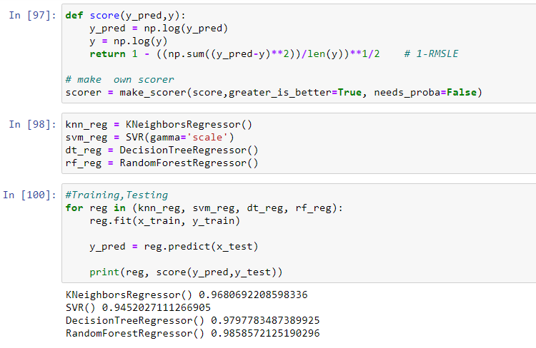

Slide 69
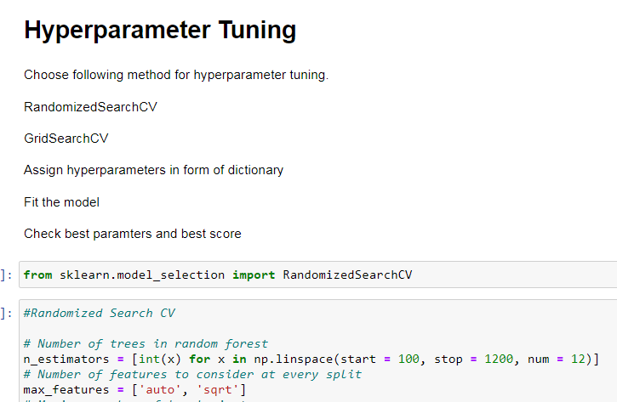

Slide 70
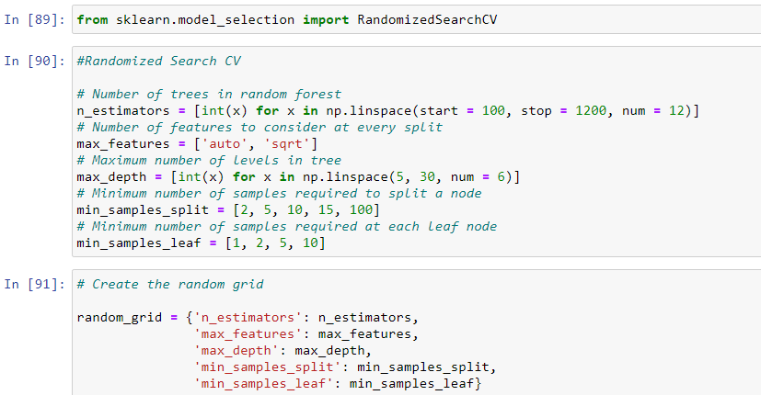

Slide 71


Slide 72


Slide 73


Slide 74


Slide 75


Slide 76


Slide 77


Slide 78


Slide 79
Interpretation of the Results Summary:
First the Flight dataset is read and analyzed reading the features we analyze ,Price is the target column here. All the features are then analyzed, missing data handling, outlier detection, data cleaning are done. Trend of Price is observed for change in individual features. New features are extracted, redundant features dropped and categorical features are encoded accordingly.
I take a look at the first few rows using the data dictionary provided.I get a sense of what each column represents,I identify the predictors and response variables.I check if there is any unique identifier for each column.

Slide 80
made a note of all the observations as a part of data understanding,in the data there are 1619 variables out of which price is the responsible variable and all the predictors.
Name of the Airlines and Journey Date is the unique identifier for each record as a part of data preparation. I start with data cleaning,i start with null values and data types of each column,i bring all the string values together.
Creating dummy variables increases the number of features greatly, highly imbalanced columns are dropped.

Slide 81
created dummy variables to convert categorical variables to numeric variables.
We need this because linear regression can only be done with numeric variables.
Before modelling, we divided the model into training and testing data.
70% random samples for training data and remaining 30% for testing data.
I began data modelling by creating the first model as Linear regression with all the variables of training data and noted the results of the first model.
Then calculated the Original price and Predicted price from the values observed.

Slide 82
Plotted the graph of feature importances for better visualization and the residual of the final to ensure that normal distribution.
Using the Regressor models calculated the KNeighborsRegressor,SVR,DecisionTreeRegressor,RandomForestRegressor, and observed that the RandomForestRegressor is performing the good precision and calculated the Hyper parameter tuning for RandomizedSearchCV.Finally calculated the rf_random best score. Plotted the distplot and scatter plot of Y test predictions,and saved the model.

Slide 83
Thank You

